Slide 1
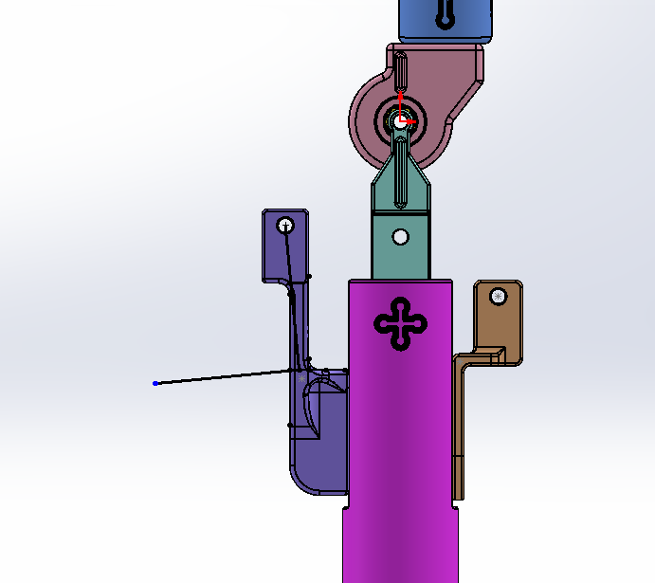
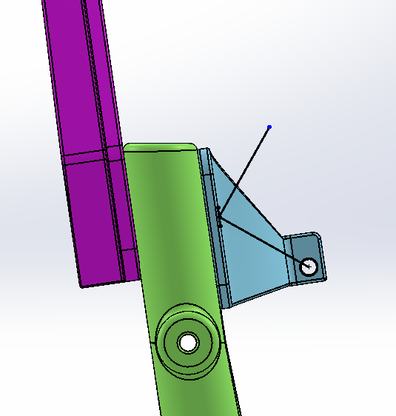
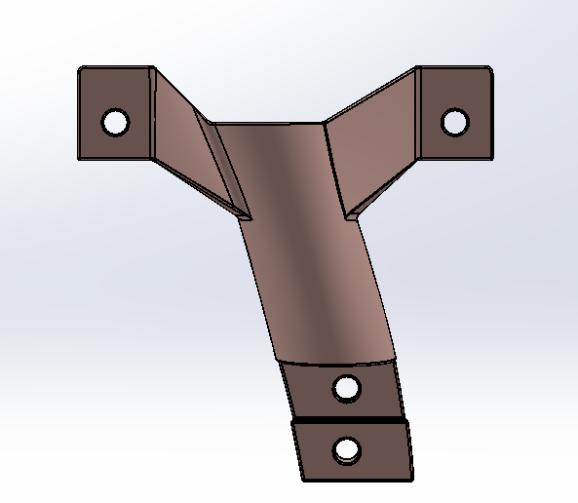
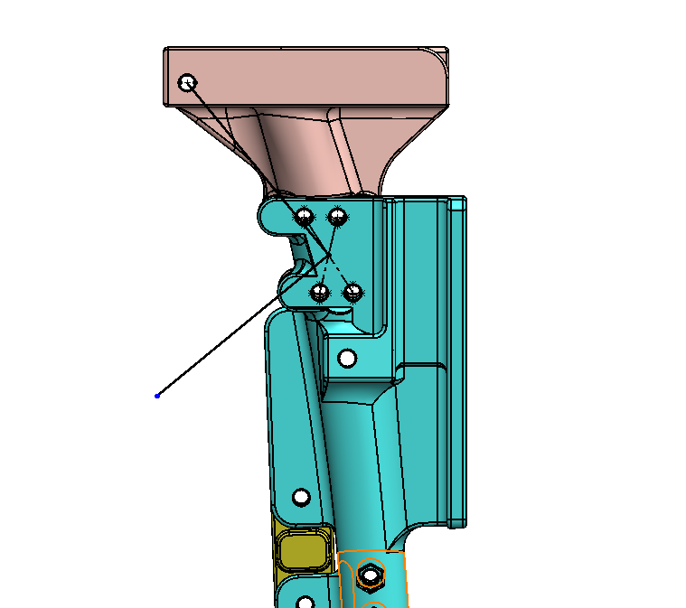
(A)
(B)
Y_{br}
X_{br}
Y_{br}
X_{br}
(C)
Y_{br}
(D)
X_{br}
X_{br}
X_{br}
Y_{br}
Y_{br}

